Slide 1
Application Security
OWASP
OWASP Top 10 (2013)
OWASP Top 10 (2017)
OWASP Top 10 vs SANS CWE 25

Slide 2
Application Security
Corporate Computer Security, 4th Edition
Randall J. Boyle & Raymond R. Panko
Chapter 8

Slide 3
Learning Objectives
Explain why attackers increasingly focus on applications.
List the main steps in securing applications.
Describe vulnerabilities in web browsers.
Explain the process of securing e-mail.
Describe how to secure other user applications.

Slide 4
8.1: Application Security Threats
Executing Commands with the Privileges of a Compromised Application
If an attacker takes over an application, the attacker can execute commands with the privileges of that application
Many applications run with super user (root) privileges

Slide 5
8.1: Application Security Threats
Few Operating Systems but Many Applications
Application hardening is more total work than operating system hardening
Understanding the Server’s Role and Threat Environment
If it runs only one or a few services, easy to disallow irrelevant things

Slide 6
8.1: Hardening Applications
Create Secure Application Program Configurations
Use baselines to go beyond default installation configurations for high-value targets
Avoid blank passwords or well-known default passwords
Install Patches for All Applications
Minimize the Permissions of Applications
If an attack compromises an application with low permissions, it will not own the computer

Slide 7
8.1: Hardening Applications
Add Application Layer Authentication, Authorizations, and Auditing
More specific to the needs of the application than general operating system logins
Can lead to different permissions for different users
Implement Cryptographic Systems
For communication with users

Slide 8

8.1: Securing Custom Applications
Custom Applications
Written by a firm’s programmers
Not likely to be well-trained in secure coding
The Key Principle
Never trust user input
Filter user input for inappropriate content

Slide 9
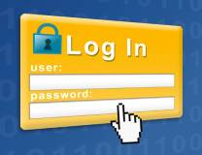
8.1: Securing Custom Applications
Buffer Overflow Attacks
In some languages, specific actions are needed
In other languages, not a major problem
Login Screen Bypass Attacks
Website user gets to a login screen
Instead of logging in, enters a URL for a page that should only be accessible to authorized users

Slide 10
8.1: Securing Custom Applications
Buffer Overflow Attacks
Vulnerabilities, exploits, fixes (e.g., patches, manual work-arounds or upgrades) (Chapter 7)
Buffers are places where data is stored temporarily
If an attacker sends too much data, a buffer might overflow, overwriting an adjacent section of RAM

Slide 11
8.1: Securing Custom Applications
Cross-Site Scripting (XSS) Attacks
One user’s input can go to another user’s webpage
Usually caused if a website sends back information sent to it without checking for data type, scripts, etc.
https://www.youtube.com/watch?v=cbmBDiR6WaY

Slide 12
8.1: Securing Custom Applications
SQL Injection Attacks
For database access
Programmer expects an input value—a text string, number, etc.
May use it as part of an SQL query or operation against the database
May accept a last name as input and return the person’s telephone number

Slide 13
8.1: Securing Custom Applications
SQL Injection Attacks
Attacker enters an unexpected string
Example: A last name followed by a full SQL query string
The program may execute both the telephone number lookup command and the extra SQL query
This may look up information that should not be available to the attacker
It may even delete an entire table

Slide 14
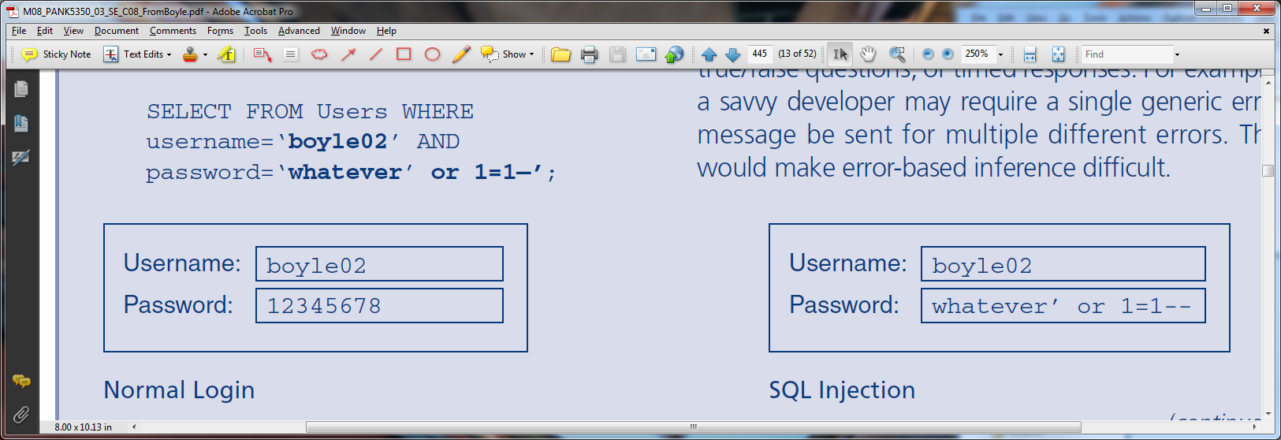
8.1: SQL Injection

Slide 15
8.1: Securing Custom Applications
Must Require Strong Secure Programming Training
General principles
Programming-language-specific information
Application-specific threats and countermeasures

Slide 16
8.2: WWW and E-Commerce
Webservice versus E-Commerce Service
WWW service provides basic user interactions
Microsoft Internet Information Server (IIS), Apache on UNIX, other webserver programs
E-commerce servers add functionality—order entry, shopping cart, payment, etc.
Links to internal corporate databases and external services, such as credit card checking
Custom programs written for special purposes

Slide 17
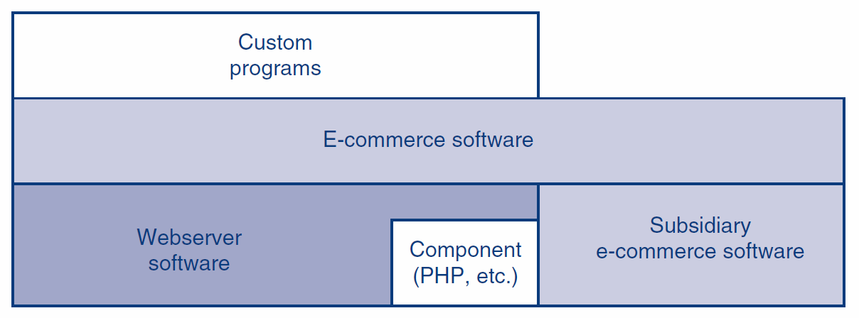
8.2: WWW Service vs. E-Commerce Service

Slide 18
8.2: Webserver Attacks
Website Defacement
Numerous IIS buffer overflow attacks
Many of which take over the computer
IIS directory traversal attacks

Slide 19

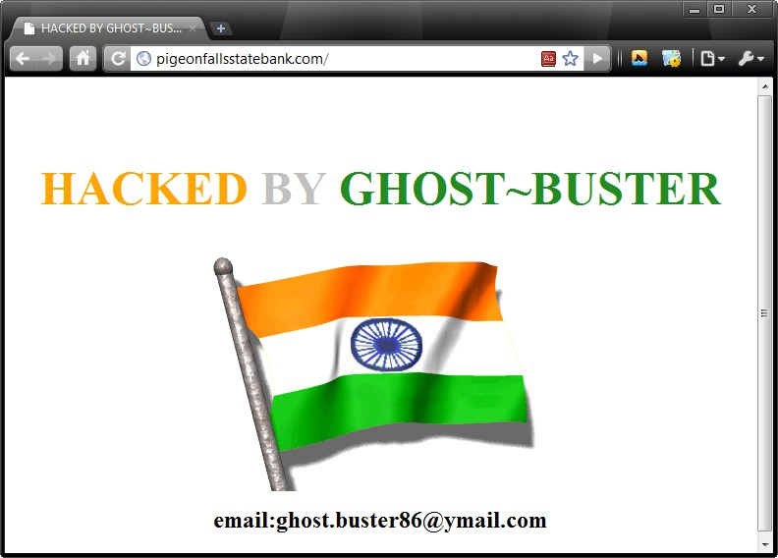
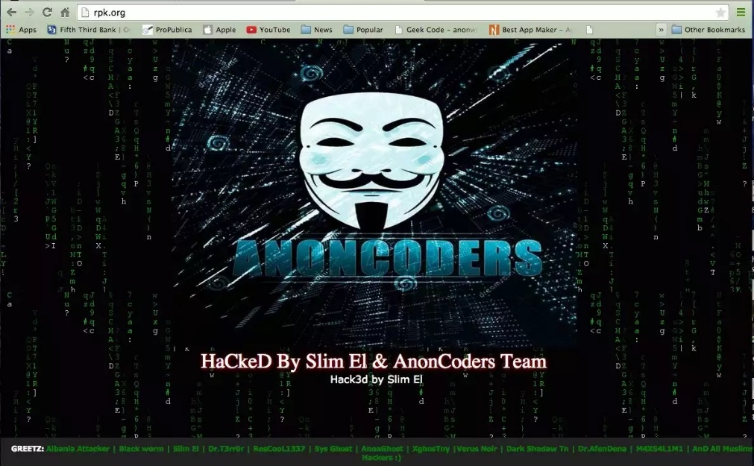
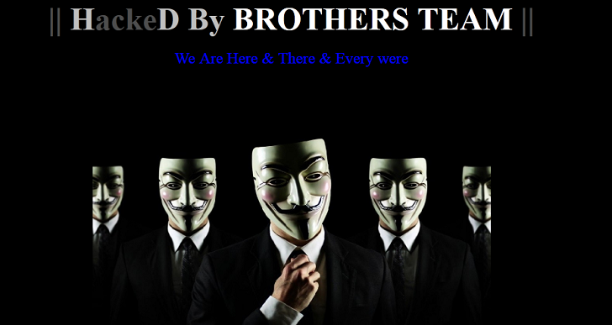
8.2: Webserver Attacks
Website Defacement

Slide 20
8.2: Directory Traversal Attack
Users should only be able to reach files below the WWW root, which is below the true system root.
https://portswigger.net/web-security/file-path-traversal

Slide 21
8.2: Directory Traversal Attack
In URLs, .. means
move up one level.
If allowed, user can
get outside the WWW root box, into other directories.

Slide 22
8.2: Webserver Attacks
IIS directory traversal attacks (Figure 8-11)
Companies filter out “..”
Attackers respond with hexadecimal and UNICODE representations for “..” and “..”
Typical of the constant “arms race” between attackers and defenders

Slide 23
8.2: Webserver and E-Commerce Protections
Patching the WWW and E-Commerce Software and Their Components
Patching the webserver software is not enough
Must also patch e-commerce software
E-commerce software might use third-party component software that must be patched

Slide 24
8.2: Webserver and E-Commerce Protections
Other Website Protections
Website vulnerability assessment tools
Reading website error logs
Placing a webserver-specific application proxy server in front of the webserver

Slide 25
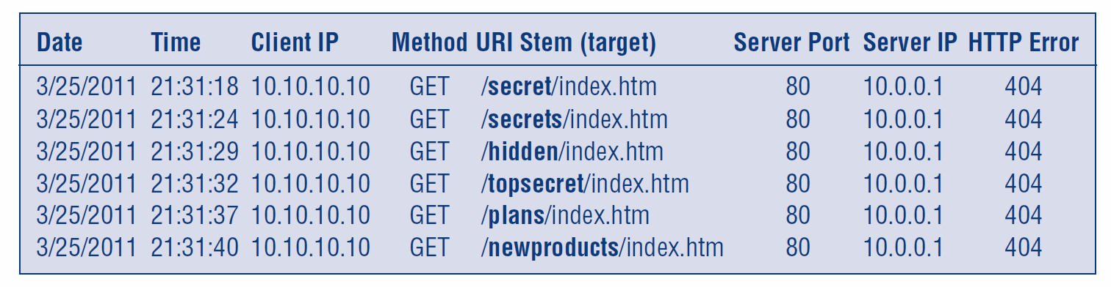
8.2: Webserver Error Logs
An internal employee (10.10.10.10) may be blindly searching for confidential directories (bolded) on an internal webserver (10.0.0.1).

Slide 26
8.3: Browser Attacks and Protections
PCs Are Major Targets
Have interesting information and can be attacked through the browser
Client-Side Scripting (Mobile Code)
Java applets: small Java programs
Usually run in a “sandbox” that limits their access to most of the system

Slide 27
8.3: Browser Attacks and Protections
You like beef?
Click here.
Malicious Links
User usually must click on them to execute (but not always)
Tricking users to visit attacker websites
Social engineering to persuade the victim to click on a link
Uses domain names that are common misspellings of popular domain names
http://www.micosoft.com

Slide 28
8.3: Browser Attacks and Protections
Other Client-Side Attacks
File reading: turns the computer into an unintended file server
Executing a single command
The single command may open a command shell on the user’s computer
The attacker can now enter many commands
C:>

Slide 29
8.3: Browser Attacks and Protections
Other Client-Side Attacks
Automatic redirection to unwanted webpage
On compromised systems, the user may be automatically directed to a specific malicious website if they later make any typing error

Slide 30
8.3: Browser Attacks and Protections
Other Client-Side Attacks – Cookies
Cookies are placed on user computer; can be retrieved by website
Can be used to track users at a website
Can contain private information
Accepting cookies is necessary to use many websites

Slide 31
8.3: Browser Attacks and Protections
Enhancing Browser Security
Patches and updates
Set strong security configuration options for Microsoft Internet Explorer
Set strong privacy configuration options for Microsoft Internet Explorer

Slide 32
8.4: E-Mail Security
Content Filtering
Malicious code in attachments and HTML bodies (scripts)
Spam: unsolicited commercial e-mail
Volume is growing rapidly; slowing PCs and annoying users (pornography and fraud)
Filtering for spam also rejects some legitimate messages

Slide 33
8.4: E-Mail Security
Inappropriate Content
Companies often filter for sexually or racially harassing messages
Could be sued for not doing so
Extrusion Prevention for Intellectual Property (IP)
Stopping the Transmission of Sensitive Personally Identifiable Information (PII)

Slide 34
8.4: E-Mail Security
Employee training
E-mail is not private; company has right to read
Your messages may be forwarded without permission
Never put anything in a message the sender would not want to see in court, printed in the newspapers, or read by his or her boss
Never forward messages without permission

Slide 35
The End

Slide 36
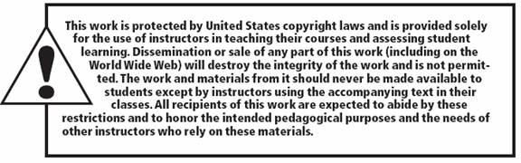
Copy right statement
All rights reserved. No part of this publication may be reproduced, stored in a retrieval system, or transmitted, in any form or by any means, electronic, mechanical, photocopying, recording, or otherwise, without the prior written permission of the publisher. Printed in the United States of America.
Copyright © 2015 Pearson Education, Inc.

